Slide 1
Solar Charger Project
Dominick Christensen

Slide 2
Motivation
Something somebody could use
My dad has no respect for battery life
I needed to do something

Slide 3
Objective
Portable Solar Phone/Battery Charger
Controlled by Arduino
Regulate 12V to 5V
Charge Phone via USB
Long Term (Stretch) Goals
Durable
Make Dad Proud

Slide 4

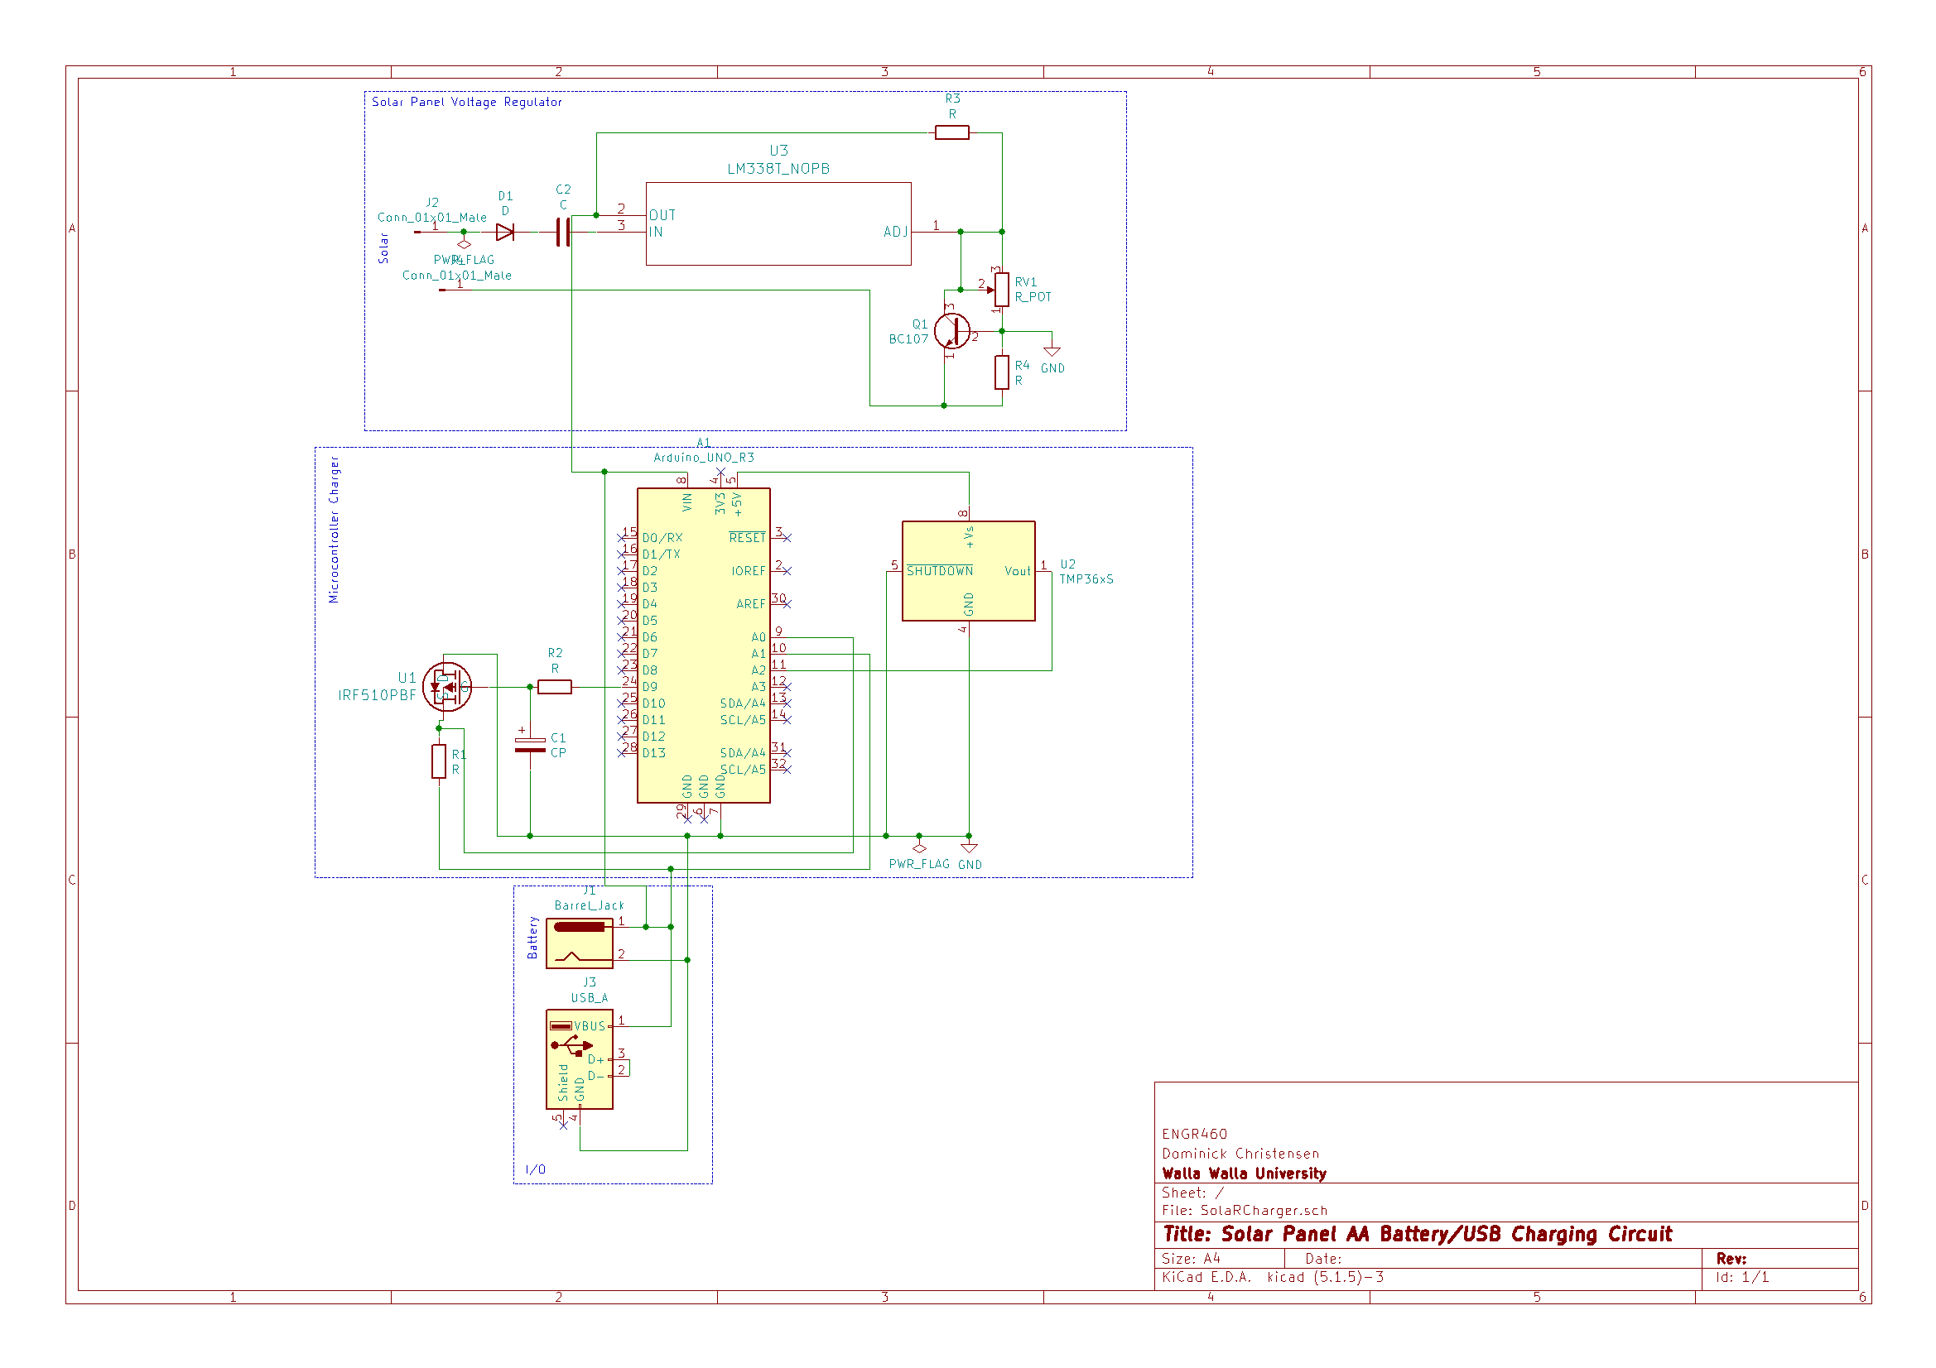
Design

Slide 5
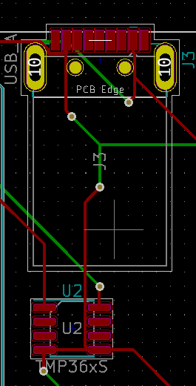
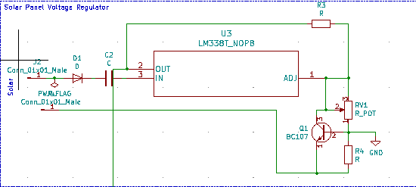

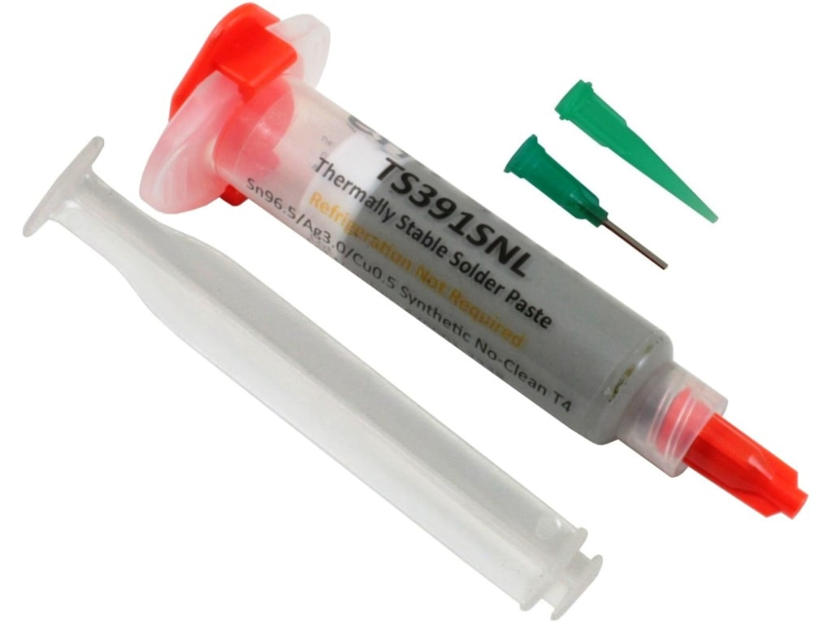
Build/Testing
Problematic
Burned some key components
Hasn’t been cleaned in generations
Could been better positioned

Slide 6
Closing Thoughts
Improve Scope
Peer Review
Have Better Contingency Plan

Slide 7

Questions?

